Slide 1

Remote sensing monitoring of vine mortality in coastal areas threatened by salinization.
Students
Bruno Spacca
Guilhem Huau
Konstantinos- Xenakis Liakopoulos
Visar Mataj
Tutors
Armand Crabit
François COLIN

Slide 2
Objective of the project
Why?
The Mediterranean coast is a particularly varied environment, sensitive to changes, such as salinization
The salinization problem: It is reported to result in an increase in the mortality of existing vegetation, particularly vines.
The objective of the project is to remote sensing monitoring coastal areas with vine mortality and salinization problems, and analyze the evolution over the years.

Slide 3
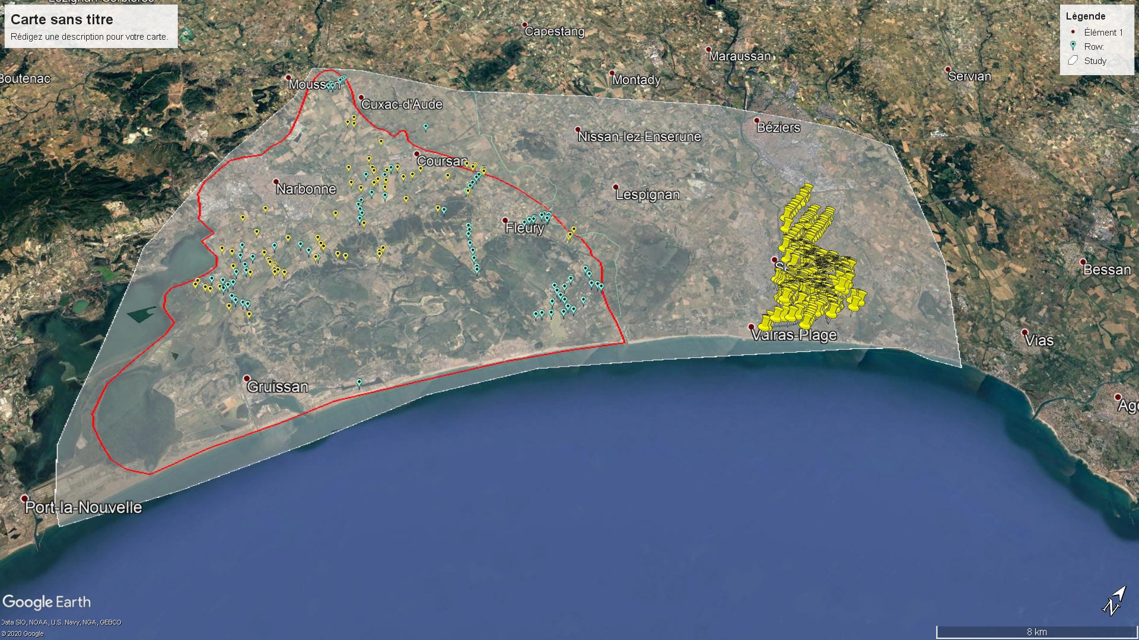
Where ?

Slide 4
Two main questions arise from this project
Methodological: what is the potential of satellite remote sensing to quantify vine mortality in coastal areas?
Cognitive: to what extent is this mortality linked to the state of salinity? What is its spatial and temporal evolution?

Slide 5
Effect of the salinity on the vine
Indicators of salinization
Increase erosion
Reduce water store capacity
Crusting on the surface
Field symptoms.
Electrical conductivity of solution (EC)
Sodium absorption ratio (SAR)
Total Dissolved Solid (TDS)
Remote sensing indices

Slide 6
Source of data
Aerial photography (if higher resolution is needed)
Satellite (LandSat, SPOT, Sentinel, Plêiades)
Can be found in IGN and Geosud
Need to be at the same time of the ground data acquisition to use them to assess the strength of the model
Measure of reflectance, NDVI for identification and if possible classification of the soil salinity

Slide 7
Tools for analysis: QGIS
Powerful GIS tools
Integration of R script to do data analysis
Use of R packages if necessary (to be found in CRAN)

Slide 8
What’s next?
Continue organizing our work on the Trello platform
Place a meeting with our tutors in the beginning of the next week in order to clarify the tasks and the things we have to focus on.
Acquire more informations about the satellites subject.
Find more information on QGIS and R for spatial analysis
Finally collect and evaluate the primarily data.

Slide 9
